Slide 1
Operating Systems
Ch 17: Protection
Dr. 何明昕 HE Mingxin, MX, Max
Send your email to c.max@yeah.net with
a subject like: OS-id-Andy: On What …
Download from c.program@yeah.net
/文件中心/网盘/OperatingSystems26S
Book site: https://codex.cs.yale.edu/avi/os-book/OS10/index.html

Slide 2
Chapter 17: Protection
Goals of Protection
Principles of Protection
Protection Rings
Domain of Protection
Access Matrix
Implementation of Access Matrix
Revocation of Access Rights
Role-based Access Control
Mandatory Access Control (MAC)
Capability-Based Systems
Other Protection Implementation Methods
Language-based Protection

Slide 3
Objectives
Discuss the goals and principles of protection in a modern computer system
Explain how protection domains combined with an access matrix are used to specify the resources a process may access
Examine capability and language-based protection systems
Describe how protection mechanisms can mitigate system attacks

Slide 4
Goals of Protection
In one protection model, computer consists of a collection of objects, hardware or software
Each object has a unique name and can be accessed through a well-defined set of operations
Protection problem - ensure that each object is accessed correctly and only by those processes that are allowed to do so

Slide 5
Principles of Protection
Guiding principle – principle of least privilege
Programs, users and systems should be given just enough privileges to perform their tasks
Properly set permissions can limit damage if entity has a bug, gets abused
Can be static (during life of system, during life of process)
Or dynamic (changed by process as needed) – domain switching, privilege escalation
Compartmentalization a derivative concept regarding access to data
Process of protecting each individual system component through the use of specific permissions and access restrictions

Slide 6
Principles of Protection (Cont.)
Must consider “grain” aspect
Rough-grained privilege management easier, simpler, but least privilege now done in large chunks
For example, traditional Unix processes either have abilities of the associated user, or of root
Fine-grained management more complex, more overhead, but more protective
File ACL lists, RBAC
Domain can be user, process, procedure
Audit trail – recording all protection-orientated activities, important to understanding what happened, why, and catching things that shouldn’t
No single principle is a panacea for security vulnerabilities – need defense in depth

Slide 7
Protection Rings
Components ordered by amount of privilege and protected from each other
For example, the kernel is in one ring and user applications in another
This privilege separation requires hardware support
Gates used to transfer between levels, for example the syscall Intel instruction
Also traps and interrupts
Hypervisors introduced the need for yet another ring
ARMv7 processors added TrustZone(TZ) ring to protect crypto functions with access via new Secure Monitor Call (SMC) instruction
Protecting NFC secure element and crypto keys from even the kernel

Slide 8
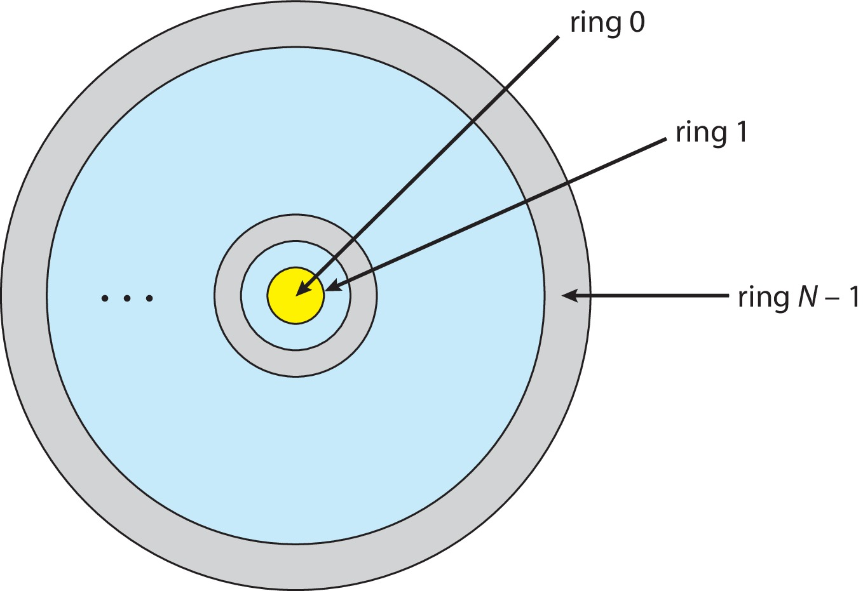
Protection Rings (MULTICS)
Let D_{i} and D_{j} be any two domain rings
If j < I ⇒ D_{i} ⊆ D_{j}

Slide 9
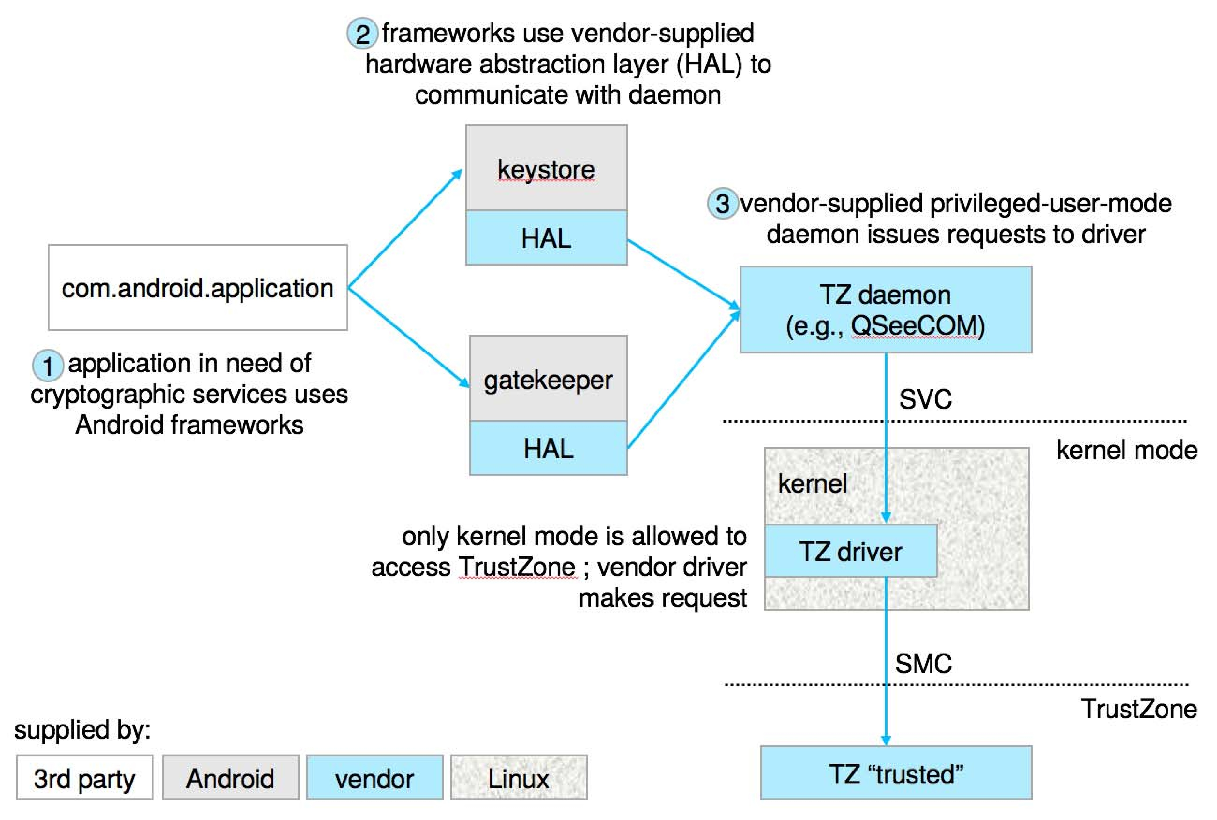
Android use of TrustZone

Slide 10
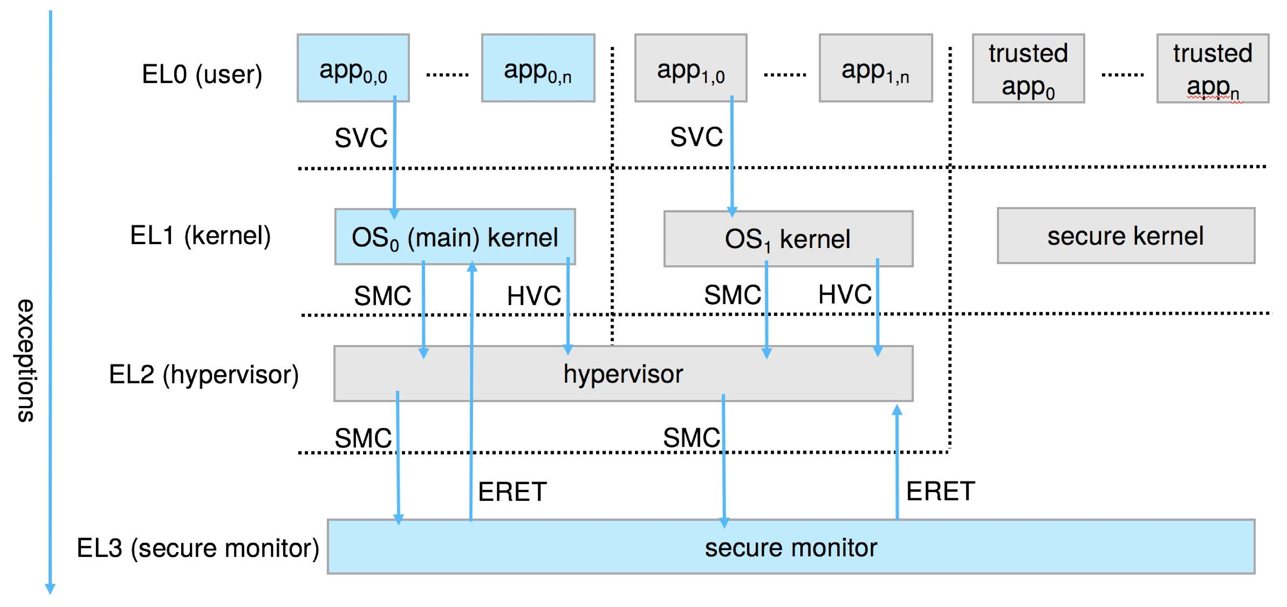
ARM CPU Architecture

Slide 11
Domain of Protection
Rings of protection separate functions into domains and order them hierarchically
Computer can be treated as processes and objects
Hardware objects (such as devices) and software objects (such as files, programs, semaphores
Process for example should only have access to objects it currently requires to complete its task – the need-to-know principle

Slide 12
Domain of Protection (Cont.)
Implementation can be via process operating in a protection domain
Specifies resources process may access
Each domain specifies set of objects and types of operations on them
Ability to execute an operation on an object is an access right
<object-name, rights-set>
Domains may share access rights
Associations can be static or dynamic
If dynamic, processes can domain switch

Slide 13
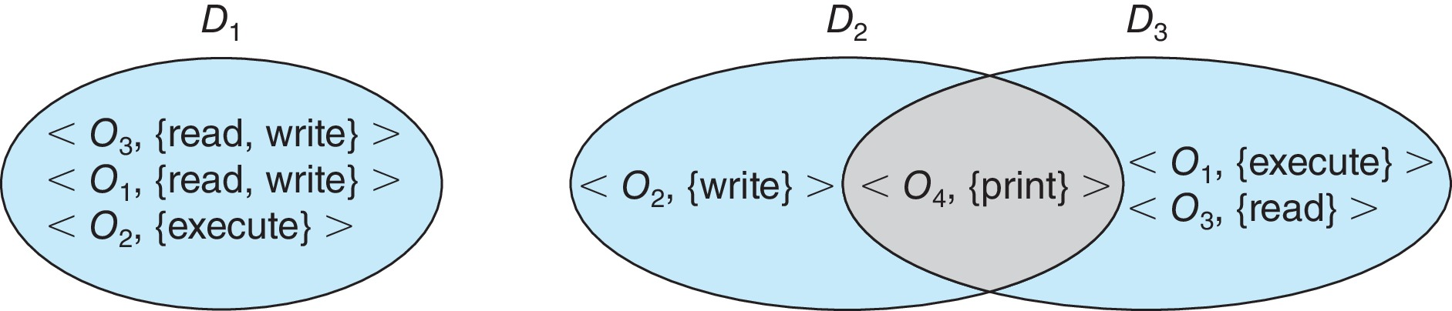
Domain Structure
Access-right = <object-name, rights-set> where rights-set is a subset of all valid operations that can be performed on the object
Domain = set of access-rights

Slide 14
Domain Implementation (UNIX)
Domain = user-id
Domain switch accomplished via file system
Each file has associated with it a domain bit (setuid bit)
When file is executed and setuid = on, then user-id is set to owner of the file being executed
When execution completes user-id is reset
Domain switch accomplished via passwords
su command temporarily switches to another user’s domain when other domain’s password provided
Domain switching via commands
sudo command prefix executes specified command in another domain (if original domain has privilege or password given)

Slide 15
Domain Implementation (Android App IDs)
In Android, distinct user IDs are provided on a per-application basis
When an application is installed, the installd daemon assigns it a distinct user ID (UID) and group ID (GID), along with a private data directory (/data/data/<appname>) whose ownership is granted to this UID/GID combination alone.
Applications on the device enjoy the same level of protection provided by UNIX systems to separate users
A quick and simple way to provide isolation, security, and privacy.
The mechanism is extended by modifying the kernel to allow certain operations (such as networking sockets) only to members of a particular GID (for example, AID INET, 3003)
A further enhancement by Android is to define certain UIDs as “isolated,” prevents them from initiating RPC requests to any but a bare minimum of services

Slide 16
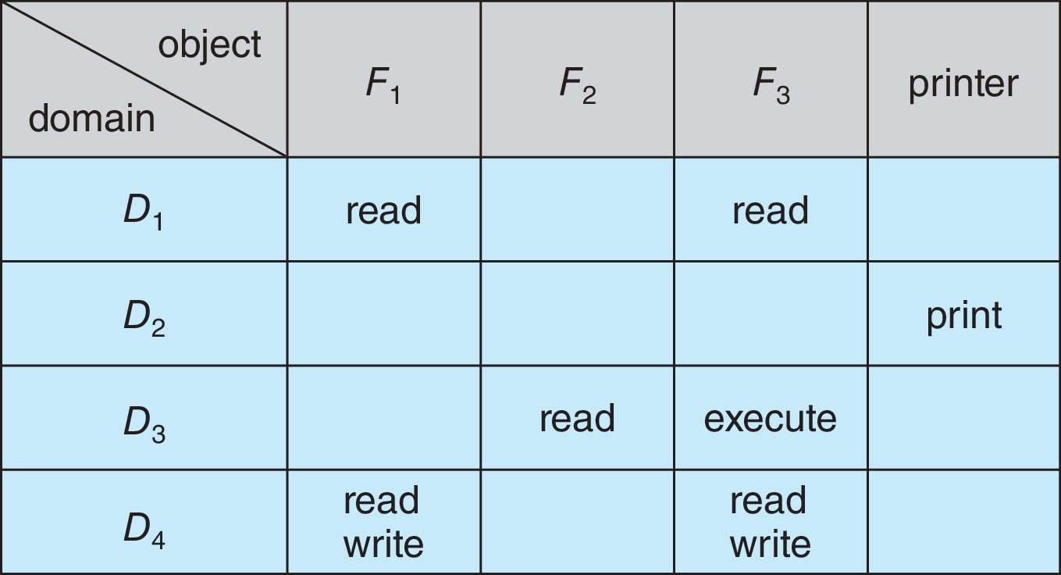
Access Matrix
View protection as a matrix (access matrix)
Rows represent domains
Columns represent objects
Access(i, j) is the set of operations that a process executing in Domain_{i} can invoke on Object_{j}

Slide 17
Use of Access Matrix
If a process in Domain D_{i} tries to do “op” on object O_{j}, then “op” must be in the access matrix
User who creates object can define access column for that object
Can be expanded to dynamic protection
Operations to add, delete access rights
Special access rights:
owner of O_{i}
copy op from O_{i} to O_{j} (denoted by “*”)
control – D_{i} can modify D_{j} access rights
transfer – switch from domain D_{i} to D_{j}
Copy and Owner applicable to an object
Control applicable to domain object

Slide 18
Use of Access Matrix (Cont.)
Access matrix design separates mechanism from policy
Mechanism
Operating system provides access-matrix + rules
If ensures that the matrix is only manipulated by authorized agents and that rules are strictly enforced
Policy
User dictates policy
Who can access what object and in what mode
But doesn’t solve the general confinement problem

Slide 19
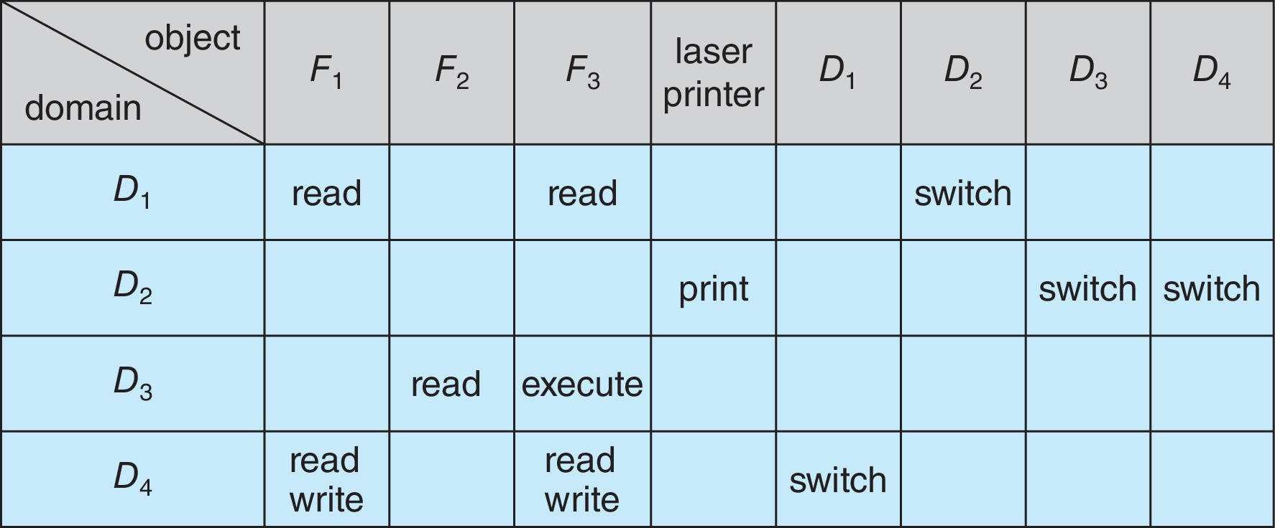
Access Matrix of Figure A with Domains as Objects

Slide 20
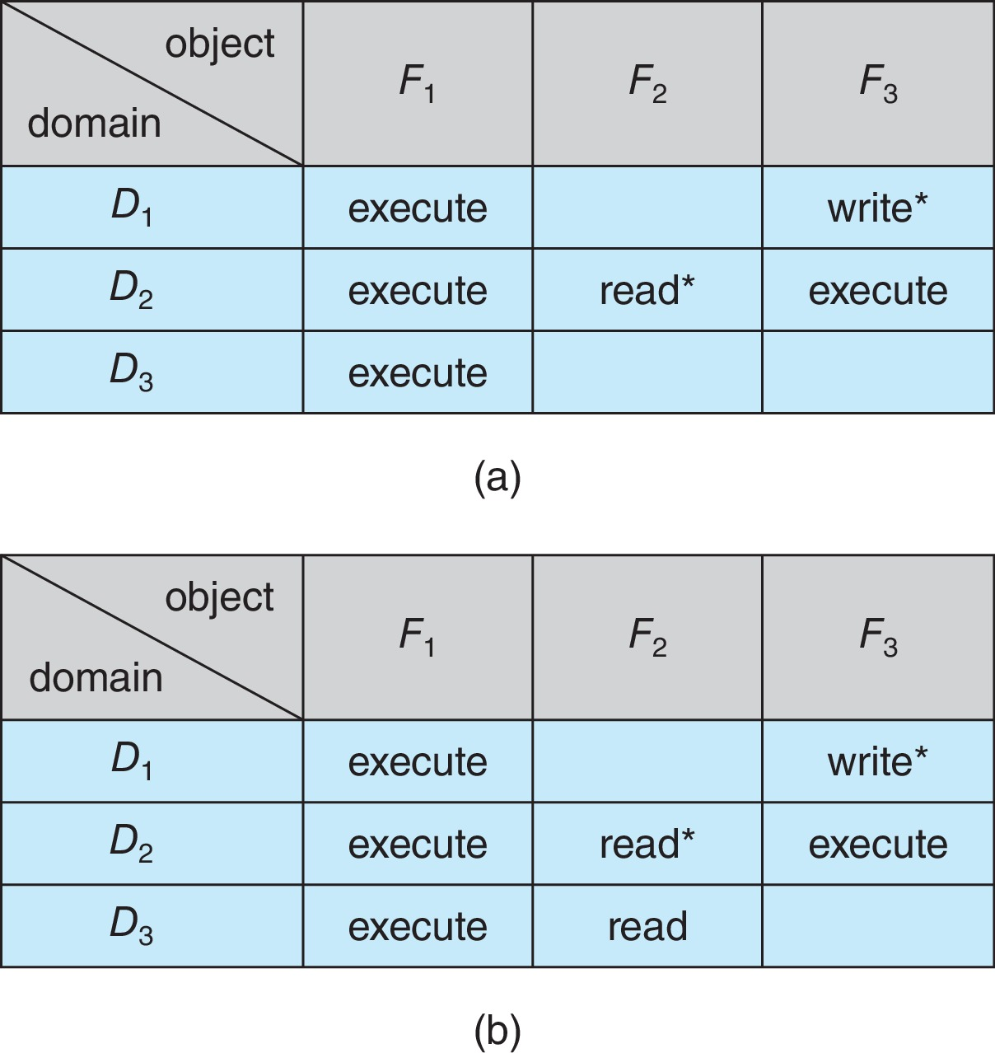
Access Matrix with Copy Rights

Slide 21
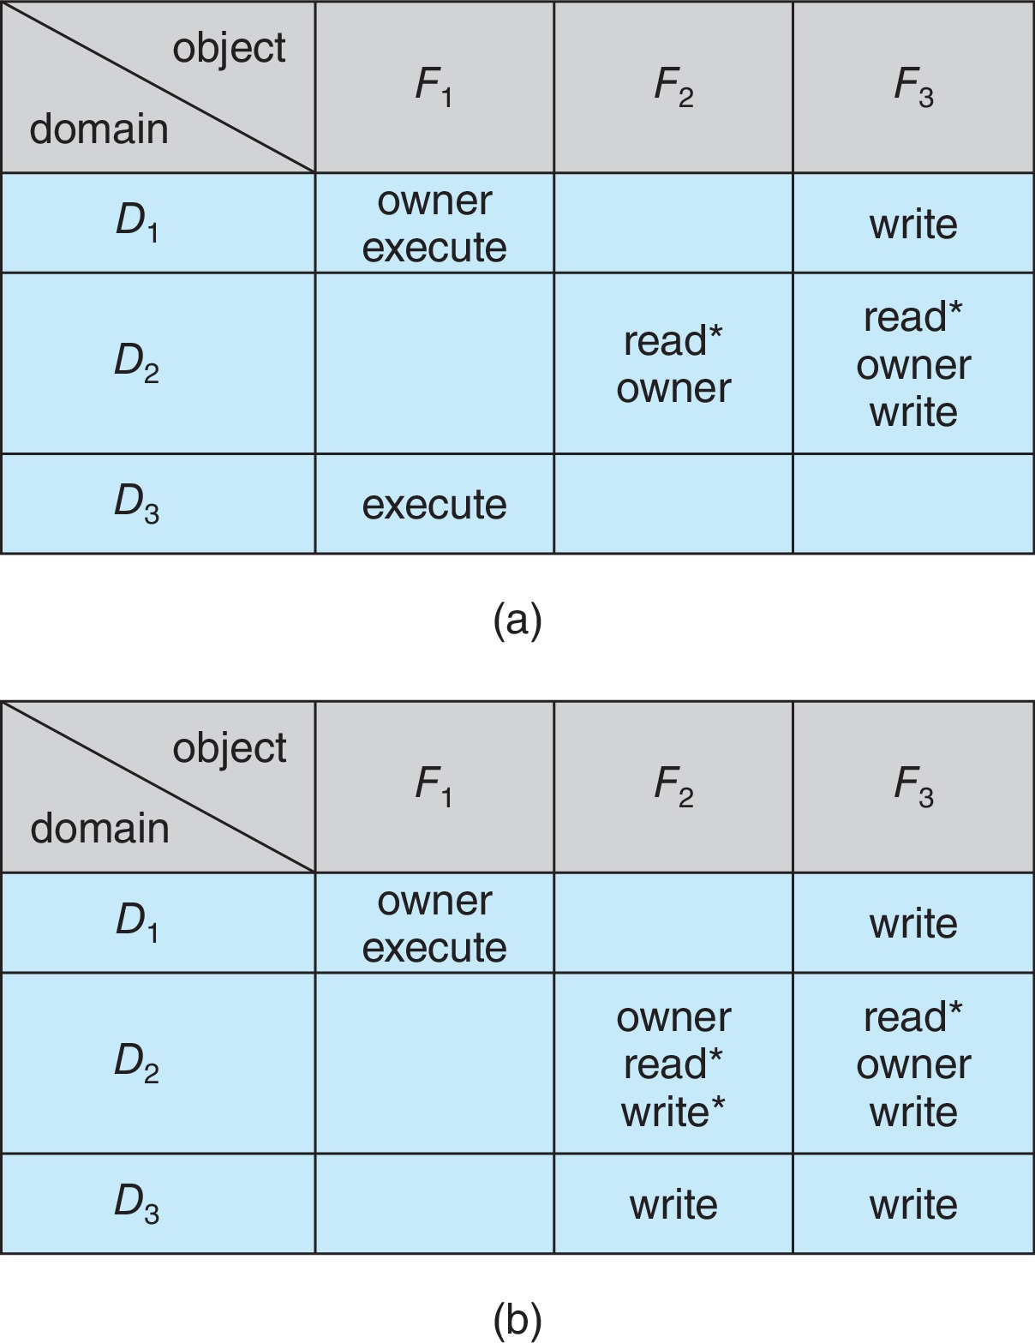
Access Matrix With Owner Rights

Slide 22
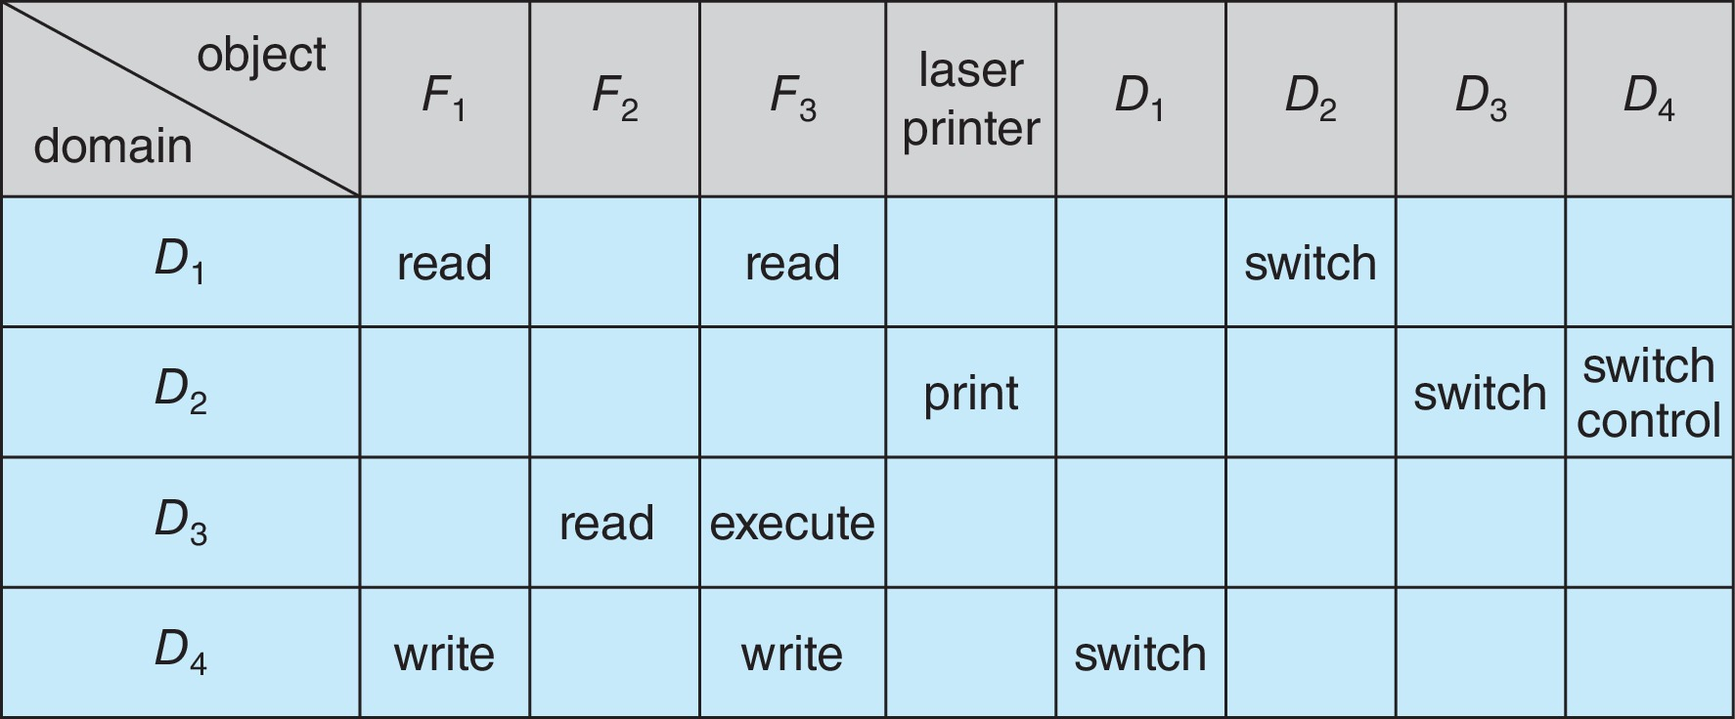
Modified Access Matrix of Figure B

Slide 23
Implementation of Access Matrix
Generally, a sparse matrix
Option 1 – Global table
Store ordered triples <domain, object, rights-set> in table
A requested operation M on object O_{j} within domain D_{i} -> search table for < D_{i}, O_{j}, R_{k} >
with M ∈ R_{k}
But table could be large -> won’t fit in main memory
Difficult to group objects (consider an object that all domains can read)

Slide 24
Implementation of Access Matrix (Cont.)
Option 2 – Access lists for objects
Each column implemented as an access list for one object
Resulting per-object list consists of ordered pairs <domain, rights-set> defining all domains with non-empty set of access rights for the object
Easily extended to contain default set -> If M ∈ default set, also allow access

Slide 25
Implementation of Access Matrix (Cont.)
Each column = Access-control list for one object Defines who can perform what operation Domain 1 = Read, Write Domain 2 = Read Domain 3 = Read
Each Row = Capability List (like a key) For each domain, what operations allowed on what objects
Object F1 – Read
Object F4 – Read, Write, Execute
Object F5 – Read, Write, Delete, Copy

Slide 26
Implementation of Access Matrix (Cont.)
Option 3 – Capability list for domains
Instead of object-based, list is domain based
Capability list for domain is list of objects together with operations allows on them
Object represented by its name or address, called a capability
Execute operation M on object O_{j}, process requests operation and specifies capability as parameter
Possession of capability means access is allowed
Capability list associated with domain but never directly accessible by domain
Rather, protected object, maintained by OS and accessed indirectly
Like a “secure pointer”
Idea can be extended up to applications

Slide 27
Implementation of Access Matrix (Cont.)
Option 4 – Lock-key
Compromise between access lists and capability lists
Each object has list of unique bit patterns, called locks
Each domain as list of unique bit patterns called keys
Process in a domain can only access object if domain has key that matches one of the locks

Slide 28
Comparison of Implementations
Many trade-offs to consider
Global table is simple, but can be large
Access lists correspond to needs of users
Determining set of access rights for domain non-localized so difficult
Every access to an object must be checked
Many objects and access rights -> slow
Capability lists useful for localizing information for a given process
But revocation capabilities can be inefficient
Lock-key effective and flexible, keys can be passed freely from domain to domain, easy revocation

Slide 29
Comparison of Implementations (Cont.)
Most systems use combination of access lists and capabilities
First access to an object -> access list searched
If allowed, capability created and attached to process
Additional accesses need not be checked
After last access, capability destroyed
Consider file system with ACLs per file

Slide 30
Revocation of Access Rights
Various options to remove the access right of a domain to an object
Immediate vs. delayed
Selective vs. general
Partial vs. total
Temporary vs. permanent
Access List – Delete access rights from access list
Simple – search access list and remove entry
Immediate, general or selective, total or partial, permanent or temporary

Slide 31
Revocation of Access Rights (Cont.)
Capability List – Scheme required to locate capability in the system before capability can be revoked
Reacquisition – periodic delete, with require and denial if revoked
Back-pointers – set of pointers from each object to all capabilities of that object (Multics)
Indirection – capability points to global table entry which points to object – delete entry from global table, not selective (CAL)
Keys – unique bits associated with capability, generated when capability created
Master key associated with object, key matches master key for access
Revocation – create new master key
Policy decision of who can create and modify keys – object owner or others?

Slide 32
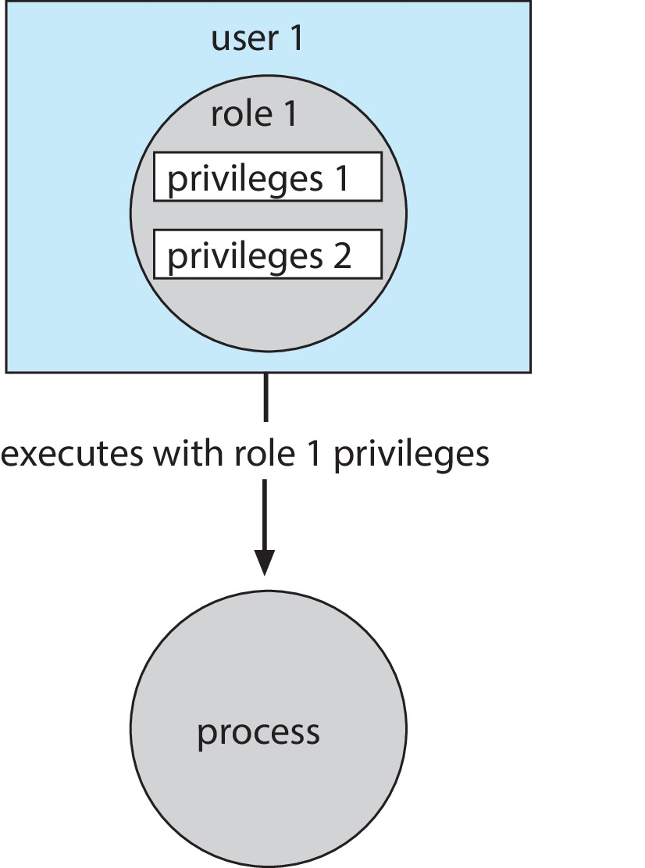
Role-based Access Control
Protection can be applied to non-file resources
Oracle Solaris 10 provides role-based access control (RBAC) to implement least privilege
Privilege is right to execute system call or use an option within a system call
Can be assigned to processes
Users assigned roles granting access to privileges and programs
Enable role via password to gain its privileges
Similar to access matrix

Slide 33
Mandatory Access Control (MAC)
Operating systems traditionally had discretionary access control (DAC) to limit access to files and other objects (for example UNIX file permissions and Windows access control lists (ACLs))
Discretionary is a weakness – users / admins need to do something to increase protection
Stronger form is mandatory access control, which even root user can’t circumvent
Makes resources inaccessible except to their intended owners
Modern systems implement both MAC and DAC, with MAC usually a more secure, optional configuration (Trusted Solaris, TrustedBSD (used in macOS), SELinux), Windows Vista MAC)
At its heart, labels assigned to objects and subjects (including processes)
When a subject requests access to an object, policy checked to determine whether or not a given label-holding subject is allowed to perform the action on the object

Slide 34
Capability-Based Systems
Hydra and CAP were first capability-based systems
Now included in Linux, Android and others, based on POSIX.1e (that never became a standard)
Essentially slices up root powers into distinct areas, each represented by a bitmap bit
Fine grain control over privileged operations can be achieved by setting or masking the bitmap
Three sets of bitmaps – permitted, effective, and inheritable
Can apply per process or per thread
Once revoked, cannot be reacquired
Process or thread starts with all privs, voluntarily decreases set during execution
Essentially a direct implementation of the principle of least privilege
An improvement over root having all privileges but inflexible (adding new privilege difficult, etc.)

Slide 35
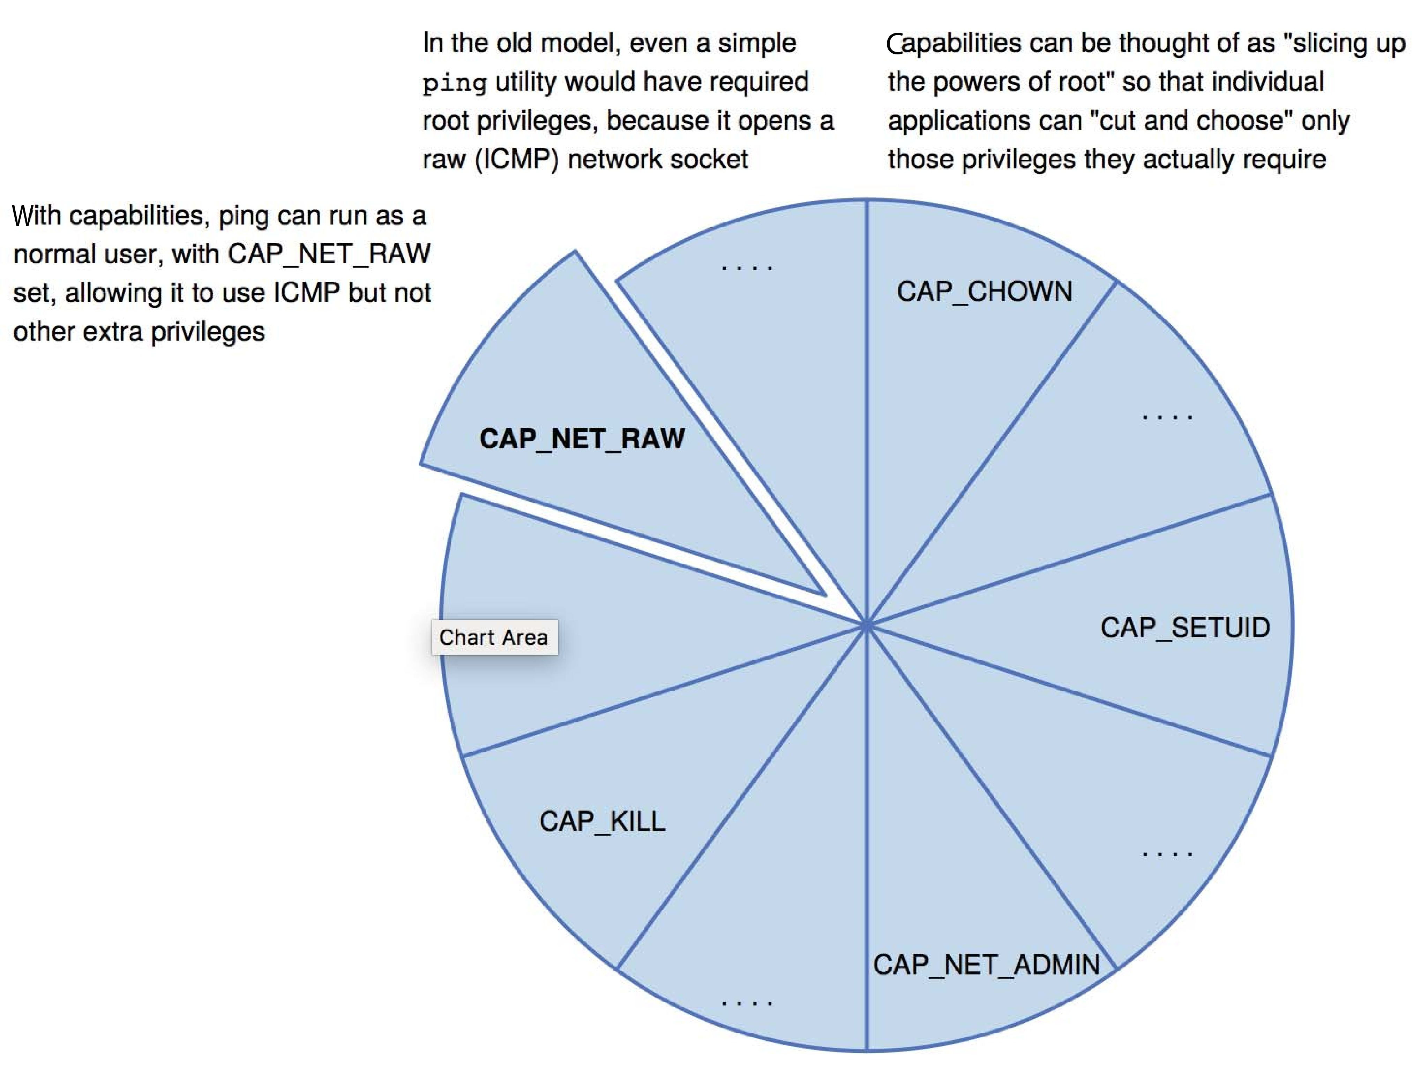
Capabilities in POSIX.1e

Slide 36
Other Protection Improvement Methods
System integrity protection (SIP)
Introduced by Apple in macOS 10.11
Restricts access to system files and resources, even by root
Uses extended file attribs to mark a binary to restrict changes, disable debugging and scrutinizing
Also, only code-signed kernel extensions allowed and configurably only code-signed apps
System-call filtering
Like a firewall, for system calls
Can also be deeper –inspecting all system call arguments
Linux implements via SECCOMP-BPF (Berkeley packet filtering)

Slide 37
Other Protection Improvement Methods (Cont.)
Sandboxing
Running process in limited environment
Impose set of irremovable restrictions early in startup of process (before main())
Process then unable to access any resources beyond its allowed set
Java and .net implement at a virtual machine level
Other systems use MAC to implement
Apple was an early adopter, from macOS 10.5’s “seatbelt” feature
Dynamic profiles written in the Scheme language, managing system calls even at the argument level
Apple now does SIP, a system-wide platform profile

Slide 38
Other Protection Improvement Methods (Cont.)
Code signing allows a system to trust a program or script by using crypto hash to have the developer sign the executable
So code as it was compiled by the author
If the code is changed, signature invalid and (some) systems disable execution
Can also be used to disable old programs by the operating system vendor (such as Apple) cosigning apps, and then invaliding those signatures so the code will no longer run

Slide 39
Language-Based Protection
Specification of protection in a programming language allows the high-level description of policies for the allocation and use of resources
Language implementation can provide software for protection enforcement when automatic hardware-supported checking is unavailable
Interpret protection specifications to generate calls on whatever protection system is provided by the hardware and the operating system

Slide 40
Protection in Java 2
Protection is handled by the Java Virtual Machine (JVM)
A class is assigned a protection domain when it is loaded by the JVM
The protection domain indicates what operations the class can (and cannot) perform
If a library method is invoked that performs a privileged operation, the stack is inspected to ensure the operation can be performed by the library
Generally, Java’s load-time and run-time checks enforce type safety
Classes effectively encapsulate and protect data and methods from other classes

Slide 41
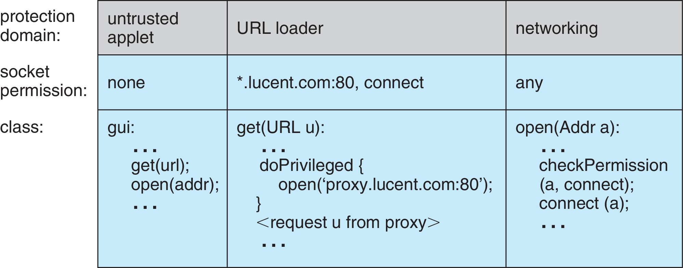
Stack Inspection

Slide 42
End of Chapter 17

